Slide 1

A literal is a constant value and is used to assign a value to variable, to compare values or define constants. e.g
boolean result = true;
char capitalC = 'C';
byte b = 100;
short s = 10000;
int i = 100000;
if (i < -10)
System.out.println(“less than -10”);
Lets understand more about literals….

Slide 2
Literal types:
Integer Literals
Floating point Literals
Character Literals and
String Literals

Slide 3
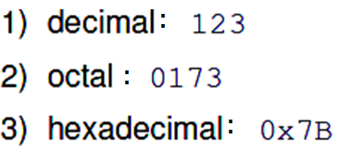
e.g. int data=1235;
e.g. long data=123572666661L;
Integer literals can be expressed in different number systems:
e.g.
int a=123; //Decimal
int b=0173; //Octal
int c=0x7B; //Hex
4) Java 7 adds: 0b100100000 OR 0B10010000 : Binary
Integer.toBinaryString(b), .toHexString(h), . toOctalString(o) etc..

Slide 4


e.g.
double d1=34.5;
double d2 = 1.234e2;
float f1 = 123.4f;
Boolean

Slide 5


String is a class. This is one of the important classes and will be studied in detail later

Slide 6


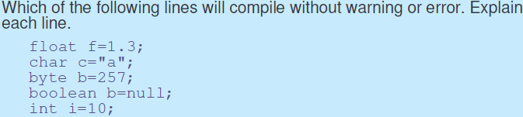

Slide 7

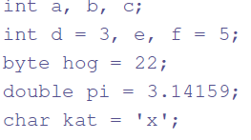

Variables declared inside methods are not automatically initialized

Slide 8
Using Underscore Characters
Java SE 7 and later, any number of underscore characters (_) can appear
can improve the readability of your code
E.g.
long creditCardNumber = 1234_5678_9012_3456L;
float pi = 3.14_15F;
cannot place underscores in the following places:
At the beginning or end of a number
Adjacent to a decimal point in a floating point literal
Prior to an F or L suffix
In positions where a string of digits is expected
int x2 = 52_;
float pi1 = 3_.1415F;
long sNo = 999_99_9999_L;// Prior to an L suffix
Integer.parseInt("123_456"); //NumFormat exception

Slide 9

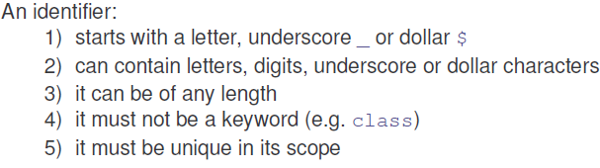
An identifier is a sequence of one or more characters.

Slide 10


SHOULD BE FOLLOWED AS ARE PART OF GOOD PROGRAMMING PRACTICE

Slide 11
Write a program to find out the hypotenuse of right angled triangle given sides s1=3.0 and s2=4.0.
Formula: hypo=SQRT (S1²+S2²)
Hint use method double Math.sqrt( double d).
public class FindHypo
{
public static void main(String args[ ])
{
double d1=3.0;
double d2=4.0;
double hypo;
hypo = Math.sqrt(d1*d1+d2*d2);//Math class in lang package
System.out.println("Hypothenuse ="+ hypo);
}
}

Slide 12


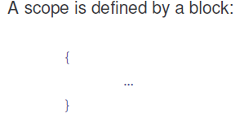
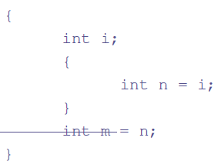

Slide 13
// Demonstrate block scope.
class Scope
{
public static void main(String args[ ])
{
int x; // known to all code within main
x = 10;
if(x == 10)
{ // start new scope
int y = 20; // known only to this block
// x and y both known here.
System.out.println("x and y: " + x + " " + y);
x = y * 2;
}
y = 100; // Error! y not known here
System.out.println("x is " + x); // x is still known here.
}
}

Slide 14

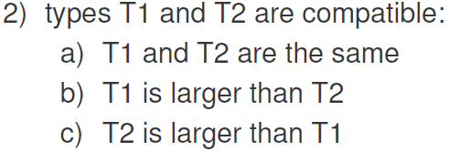
Conversion between different Data types
Suppose a value of one type is assigned to a variable of another type.
Lets look at these in more detail……

Slide 15
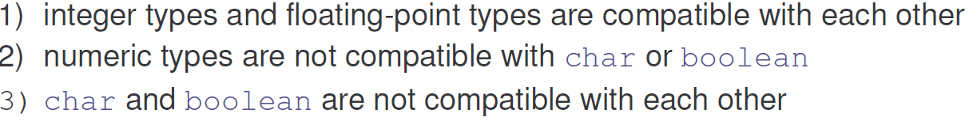
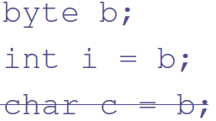
Lets see examples:
char c=‘a’;
int a=c; //OK but not appropriate

Slide 16

and
int i=100;
double d= i;// Widening

Slide 17
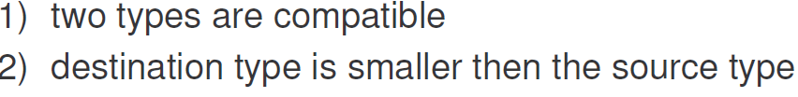
but
int i=100;
byte b= i; //Incorrect
int i=100;
byte b= (byte) i; //Necessary
important
float f=200.22f;
int i = ( int) f; //Necessary

Slide 18

QUIZ TIME
What will be output by the following Java statements?
System.out.println( (double) (12/5) );
System.out.println( (double) 12 /5 );
Answers: a. 2.0 b. 2.4

Slide 19

class Conversion
{
public static void main(String args[])
{
byte b;
int i = 257;
double d = 323.142;
System.out.println("\nConversion of int to byte.");
b = (byte) i;//After 127 reset to -128, decrease
System.out.println("i =" + i + “ and b = " + b);//257 and 1
System.out.println("\ndouble to int.");
i = (int) d;
System.out.println("d = " + d + “ and i= " + i);
}
}
Conversion of int to byte.
i =257 and b = 1
double to int.
d = 323.142 and i= 323

Slide 20
Java 7 adds:
byte aByte = 0b00100001; // Binary : An 8-bit 'byte' value:
//If value specified exceeds Byte limits, needs typecasting
byte aByte = (byte) 0b10000000;
// A 16-bit 'short' value:
short aShort = (short)0b10100001_01000101;
// Some 32-bit 'int' values:
int anInt1 = 0b10100001_01000101_10100001_01000101;
int anInt2 = 0b101;
int anInt3 = 0B101; // The B can be upper or lower case.

Slide 21


byte b1=10;
byte b2=20;
byte b3=b1+b2; //Cmpl Error
int i=b1+b2; //OK
Same is the case with short
If value >127 compile error
b = (byte) (b*2);

Slide 22
Consider value of PI = 3.14159. This value should not be changed in the program…i.e. it should be constant
Lets understand how to declare constants in Java (also called as Symbolic constants).
makes use of keyword final as shown below:
e.g.
final float PI=3.14159f; //NOT float final
final int MAX_STREANGTH=80;
final short MAX_MARKS=100;

Slide 23
Write a program to read the data from Keyboard

Slide 24
Read a char and int from keyboard
import java.util.Scanner;
class ReadData
{
public static void main(String [ ] args)
{
Scanner sc=new Scanner (System.in); //Connect to KBd
System.out.print("Enter an Char: ");
String s=sc.nextLine(); //Note readLine reads String
//You can also use next() as sometimes nextLine skips input
System.out.println("You have entered : "+ s.charAt(0));
System.out.print("Enter an integer: ");
int a=sc.nextInt();
System.out.println("You have entered : ” +a); }
}//Scanner class has .nextByte, .nextDouble, .nextLine etc…

Slide 25
Read a char and int from keyboard
Other Approach to Read the Data from Keyboard

Slide 26
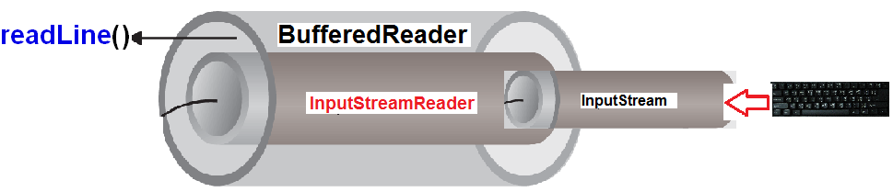
Program to read the data from Keyboard- Read the int, float and double Approach 2- using Reader classes
readline() method returns data as String.
Needs to be converted to primitive data types.

Slide 27
import java.io.*;
class ReadData {
public static void main(String[] args)
{
InputStreamReader is=new InputStreamReader(System.in);
/*System is a class in lang package, in is object of InputStream that reads byte, is converted to character by InputStreamReader .
*/
//BufferedReader buffers the characters
BufferedReader br= new BufferedReader(is);
//Declare variables to store data being read

Slide 28
String input = null; int number = 0; float fnumber=0.0f; double dnumber=0;
try
{
System.out.println("Enter an integer");
input = br.readLine();//Read it as a String
//Usage of Wrapper class methods for converting to prim data type
number = Integer.parseInt(input);//Convert String to int
System.out.println("Enter a float");//Can enter 22.3 or 22.3F
input = br.readLine();
fnumber = Float.parseFloat(input);
System.out.println("Enter a double");
input = br.readLine();
dnumber = Double. parseDouble(input);
} catch (Exception ex)
{
System.out.println(“Error entering input");
}//BufferedReader is thread safe (usage of same object by multiple threads)
}}//End of main method class

